Slide 1

PHISHING WEBSITE DETECTION USING MACHINE LEARNING
ICCSCE-293
26-04-2025
by
K. Sravani
S. Naveen Sai
S. Eepsitha
T. Sai Avinash
under the guidance of
D. Sowjanya
Assistant Professor

Slide 2

Contents
1.Abstract
2.Introduction
3. Existing System
4. Proposed System
5. Methodology
6. Dataset Description
7.Architecture
8.Work Flow of the System
9. Results
10.Comparative Analysis
11.Literature Survey
12.Conclusion
13.Publication Details

Slide 3
Introduction
Cybercriminals often create fake versions of legitimate websites to steal sensitive user information like login credentials, images, and bank details. This project uses Machine Learning (ML) to detect and prevent such phishing attacks. By analyzing data patterns and anomalies in website URLs, our system can identify fraudulent sites and enhance online safety. With the rise in cyberattacks, our ML-based solution adapts over time to stay ahead of threats. The project also prioritizes user privacy and ethical practices. Ultimately, it aims to create a safer digital environment for users.

Slide 4
Existing System
The existing system uses machine learning and data analysis to detect phishing websites. H. Huang et al. (2009) proposed identifying phishing by analyzing CSS style and URL tokens. S. Marchal et al. (2017) used real-site server logs for detection, offering high accuracy and adaptability. Mustafa Aydin et al. applied URL feature extraction and five analysis types, including Keyword and Security Analysis. Various ML models were tested, including Logistic Regression, Multinomial Naive Bayes.Logistic Regression outperformed the others with 96.63% accuracy. Preprocessing steps like tokenization and stemming were also used. This system effectively combines feature extraction with machine learning for phishing detection.

Slide 5
Drawbacks of Existing System:
The current models are characterized by low latency.
Current systems lack an explicit user interface.
Current models cannot predict a continuous outcome.
Only when the dependent or outcome variable is dichotomous does the model function.
The model may yield inaccurate results if the sample size is small.
vi. The model may be overfit due to an existing system.

Slide 6
Proposed System:
We developed an interactive website to detect whether a site is legitimate or phishing. Built using HTML, CSS, JavaScript, and Python’s Flask framework, it ensures ease of use for all users. HTML provides the structure, while CSS enhances the design and user experience. The system is trained on a dataset with various features relevant to phishing detection. Gradient Boosting Classifier is used for model training. Once trained, the model predicts whether a site is phishing or legitimate based on input features. Users receive a prompt with the result. The system achieved a detection accuracy of 97%.

Slide 7
Methodology:
The methodology begins with data collection, using a phishing dataset that includes various features relevant to identifying phishing websites. Data preprocessing follows, where unnecessary values are removed, and relevant features are selected. Feature extraction techniques are applied to analyze URL characteristics. The Gradient Boosting Classifier is then trained using this cleaned and processed data. Once trained, the model predicts whether an input URL is phishing or legitimate. A Flask-based web application is used to deploy the model. Users enter a URL, and the system displays the prediction result in real-time.

Slide 8
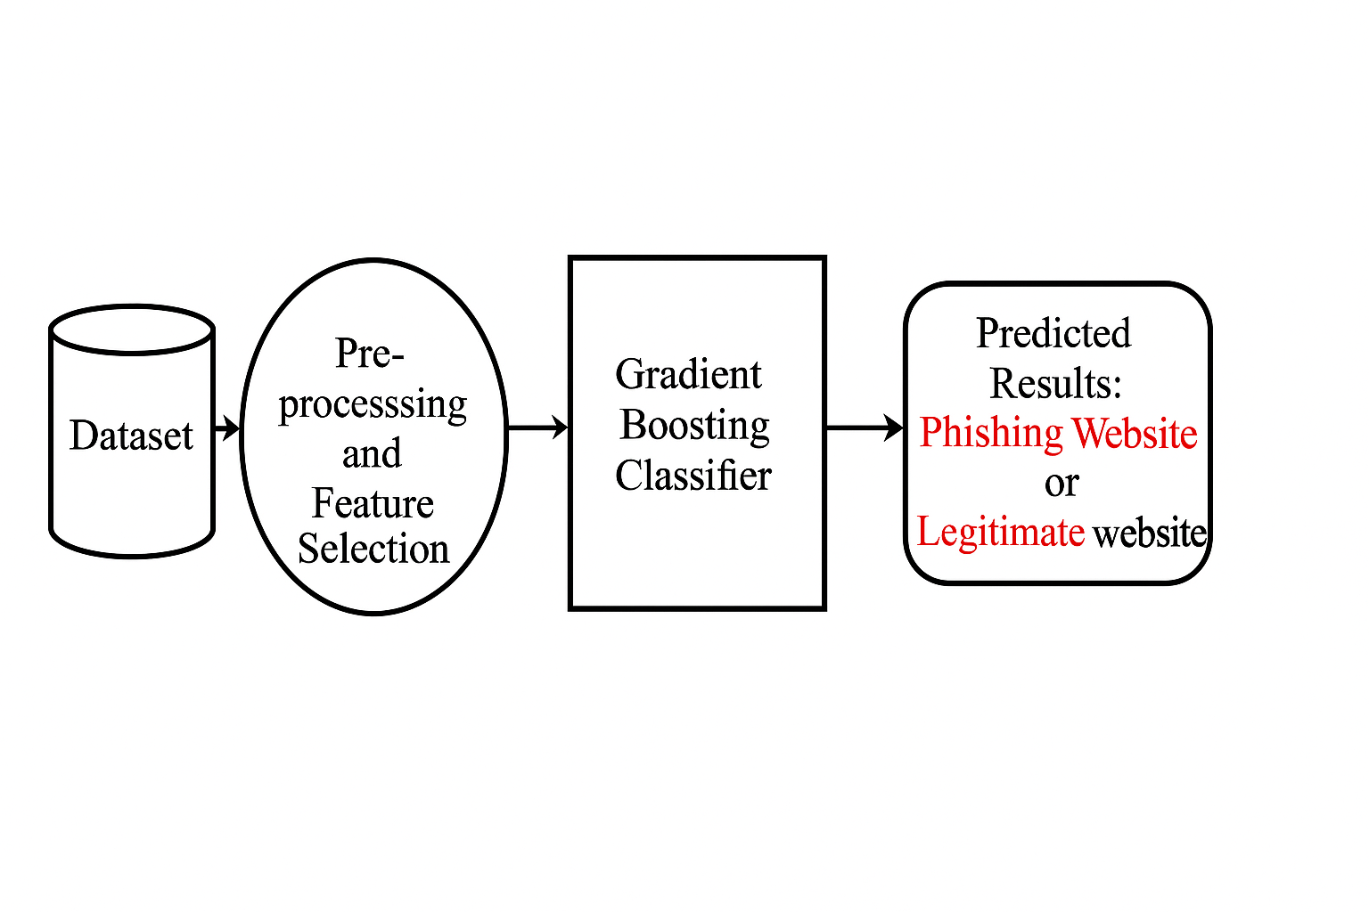
Architecture:

Slide 9
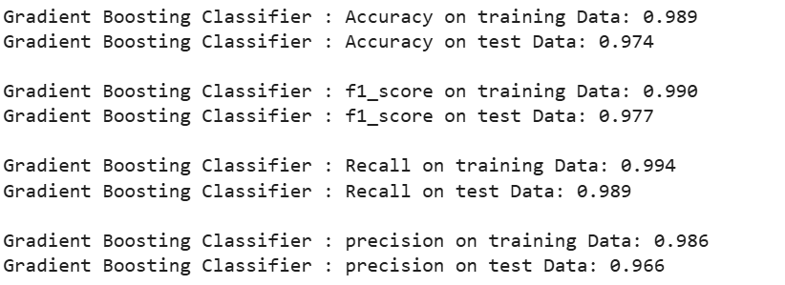
Results:
Results indicate the Gradient Boosting Classifier as the most effective model, achieving 98% accuracy on the testing set and 97% on the training set.

Slide 10
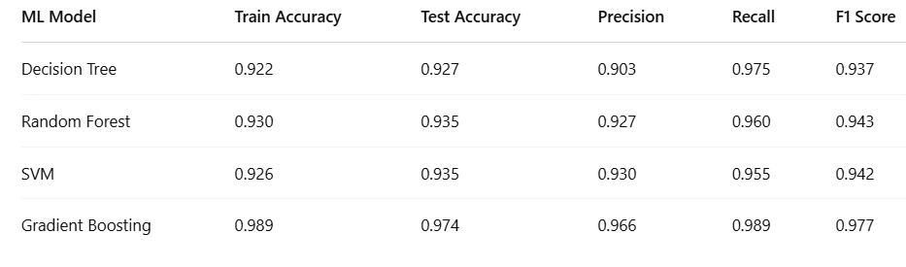
Comparative Analysis:

Slide 11
Literature Survey:
1. Andrew Jones et al. (2013)
This review focuses on the vulnerabilities exploited by phishing attacks, primarily targeting weaknesses in user behavior and system flaws.Phishing is a complex threat with no universal solution; different techniques are needed for detection, defense, and prevention of attacks.
2. Alessandro Acquisti et al. (2017)
This paper explores how technological advances have increased the complexity of privacy and security decisions.It examines how individuals make decisions about privacy, the challenges they face, and suggests soft interventions (like prompts) to guide users toward better security choices.

Slide 12


Interface:

Slide 13



Slide 14
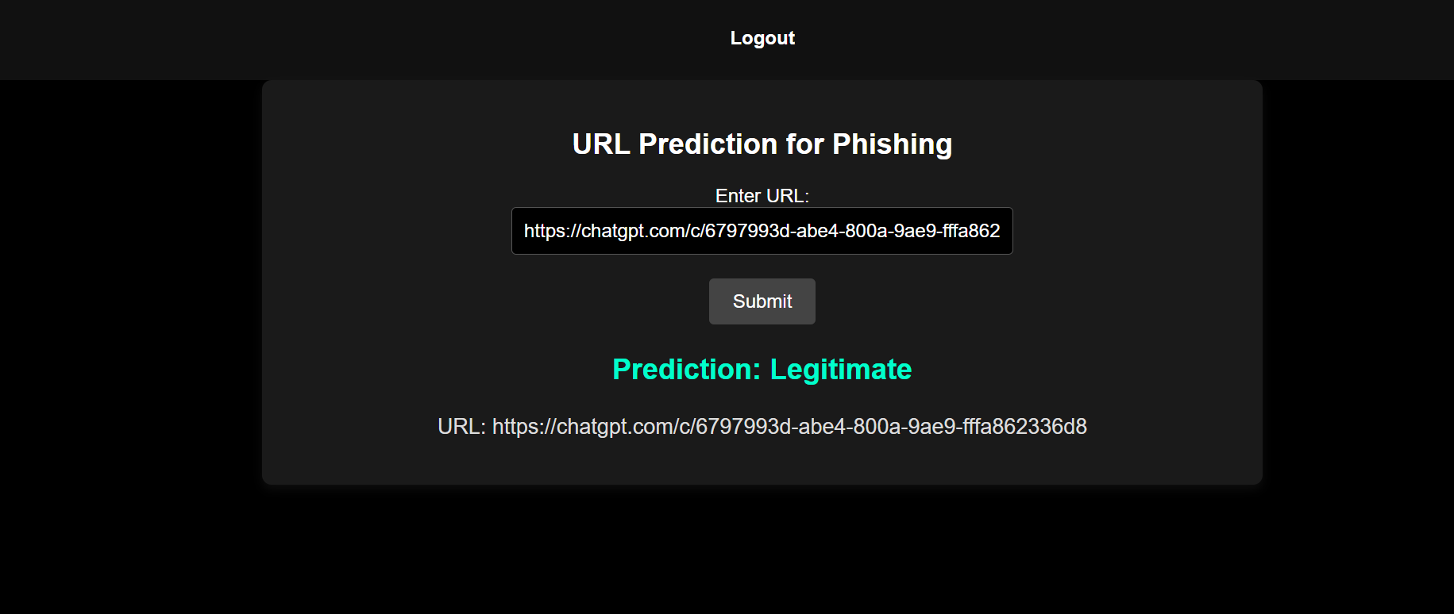


Slide 15
Conclusion:
In conclusion, the implementation of algorithms has demonstrated promising potential in fortifying our defenses against the pervasive threat of phishing attacks. Through the development and refinement of sophisticated models, this project has showcased the viability of leveraging data-driven approaches to swiftly identify and neutralize fraudulent websites. Considering the never-ending evolution of cyber threats in the world today, we must also note that the findings here emphasize the need for continual innovation and adaptation in cybersecurity. The research done here will significantly contribute to ongoing efforts to protect people and organizations online and could serve as a launching pad for more proactive threat detection in the future.

Slide 16
THANK YOU

